Slide 1

Principles of Economics
Swagat Kishore Mishra
Lecturer, Dept. of Economics
Email: swagat@bits-goa.ac.in / sayswagat@gmail.com
VOIP: 207 PSRN: 485 CHAMBER: A-301/16
Tel. 0832-2580207 (O) 08879506995 (M)
Lecture-6

Slide 2
Contents
Production Possibility Frontier (PPF)
Opportunity Cost
Circular flow of economic activity
The price system: Rationing and Allocating Resources
Revealed Preference Theory

Slide 3

Production Possibility Frontier (PPF)
Just as individuals face scarcity of resources, the resources of an economy as a whole are always limited in comparison to what the people in the economy collectively want to have.
i.e. every society has to determine how to allocate its scarce resources to different goods and services.
An allocation of the scarce resource of the economy gives rise to a particular combination of different goods and services.
Given the total amount of resources, it is possible to allocate the resources in many different ways and, thereby achieving different mixes of all possible goods and services.

Slide 4
The collection of all possible combinations of the goods and services that can be produced from a given amount of resources and a given stock of technological knowledge is called the production possibility set of the economy.
Example:
Consider an economy which can produce rice or wool by using its resources.
Possibilities | Rice | Wool
A | 0 | 10
B | 1 | 9
C | 2 | 7
D | 3 | 4
E | 4 | 0

Slide 5
If all resources are used in the production of:
Rice then maximum amount produced is 4
Wool then maximum amount produced is 10
The economy can also produce 1 unit of Rice and 9 units of Wool or 2 units of Rice and 7 units of Wool or 3 units of Rice and 4 units of Wool.
There can be many other possibilities.

Slide 6
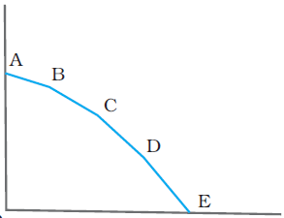
WOOL
The curve gives the maximum amount of Rice that can be produced in the economy for any given amount of Wool and vice-versa. Called PPF.
0,10
1,9
2,7
3,4
4,0
0
RICE
The production possibility frontier gives the combinations of Rice and Wool that can be produced when the resources of the economy are fully utilized.
Note: A point lying strictly below the production possibility frontier represents a combination of Rice and Wool that will be produced when all or some of the resources are either underemployed or are utilized in a wasteful fashion.

Slide 7
Opportunity cost
Every economy has to choose one of the many possibilities that it has.
i.e. one of the central problems of the economy is to choose from one of the many production possibilities.
There is always a cost of having a little more of one good in terms of the amount of the other good that has to be forgone.
This is known as the opportunity cost of an additional unit of the goods.
It is also referred as the economic cost showing a type of tradeoff.

Slide 8
“The benefit/utility lost from the best alternative you forego.”
Example: College:
Direct costs: tuition fees, books, commuting, …
Possible opportunity costs:
A. salary you would have earned in the meantime (if working was your preferred alternative)
B. the utility derived from backpacking, an exchange year, … (if this was your preferred alternative)

Slide 9
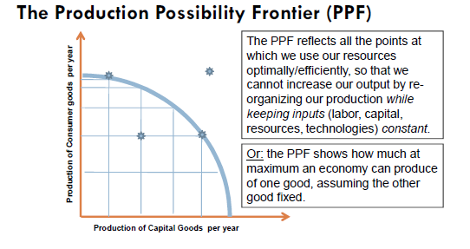

Slide 10
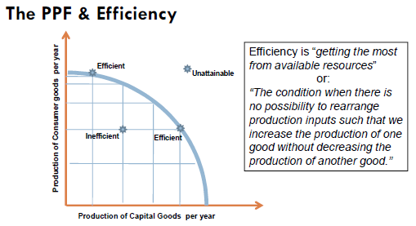
So the PPF reflects all the points at which we use our resources optimally/efficiently, so that we cannot increase our output by re-organizing our production while keeping inputs (labor, capital, resources, technologies) constant.

Slide 11
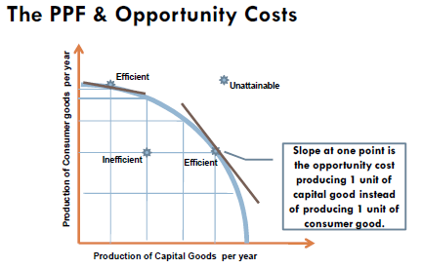

Slide 12
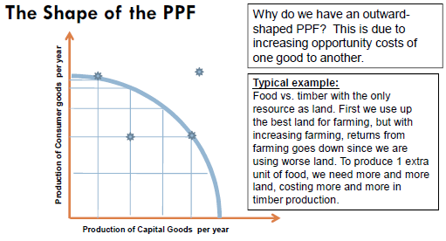

Slide 13
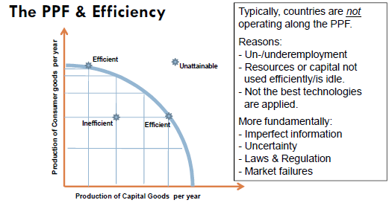

Slide 14
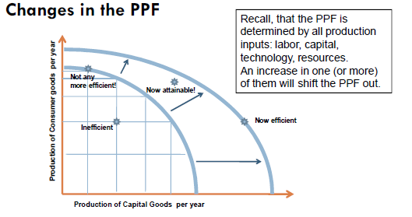

Slide 15
Circular flow of economic activity
A framework of summarizing the flows of commodities and payments that link the household and firm sectors of the economy.
It establishes the relationship between factors of production Land, Labor, Capital and Organization with their factor payments Rent, Wage, Interest and Profit respectively.

Slide 16












Households
Labor Supplied
Goods Purchased
Payments for goods
PROFITS, INTEREST AND
DIVIDEND INCOME
SAVINGS
Wage Income
Product Market
Labor Market
Capital Market
Revenue
Wages paid
INVESTMENT
PROFITS, INTEREST AND
DIVIDEND PAYMENTS
Labor Hired
Goods Produced
Firms

Slide 17













Consumption Expenditure
Markets for goods and services
Goods and Services
Business Firms
Households
Economic Resources
Markets for Resources
Money Incomes
The Circular Flow of Economic Activity

Slide 18
The Circular Flow of Economic Activity
Inner Loop : Flow of resources from household to business firms and the flow of goods and services to households.
Outer Loop : Flow of money incomes from business firms to households and the flow of consumption expenditure from households to firms.
Prices of goods are determined by the top half of the diagram and the prices of resources are determined by the bottom half.

Slide 19
The price system:
Rationing and Allocating Resources
An economic system with its specialization of economic activities under ownership and decision units (Government) decides on distribution of scarce resources (among unlimited wants).
The process is concerned with the fact that the exchange of goods and the maintenance of control over the use of goods impose costs on traders and owners. It is also concerned with the cost of government alternatives to the market place.

Slide 20
Revealed Preference (RP) Theory (Part-1)
Literature on Revealed Preference has proliferated with Samuelson introducing it in 1938.
It establishes ‘law of demand’ without use of Indifference curves given by Hicks and Allen.
History accounts for ‘Integrable problem’ outlined by Antonelli which referred to answer ‘Can utility function induce a given a demand function?’
Samuelson, Houthakker and Uzawa worked towards answering this question.
The second question developed by Arrow and Uzawa has been ‘Can a preference function induce a given demand function?’

Slide 21
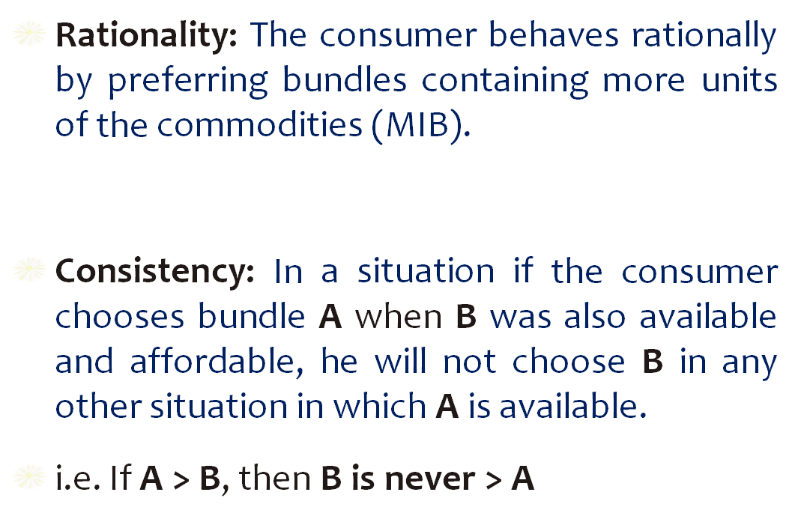
Assumptions of RP theory are:

Slide 22
Transitivity: In any particular situation A > B and B > C then A > C.
The Revealed Preference axiom: By choosing a collection of goods in any one budget situation, the consumer reveals his preference for that particular combination. i.e. The chosen basket of goods maximizes his utility.
WARP: Given the price and income if you chose A when B was affordable, then A is defined to be revealed preferred to B and B can never reveal to be better than A. (Weak Axiom)
SARP: If A reveals itself to be better than B, and if B reveals itself to be better than C, etc… then A can be defined to be revealed to be better to Z, the last in the chain of bundles. (Strong Axiom)
Samuelson, 1996

Slide 23
Revealed Preference (RP) Theory- Part 2
Definition:
Given some vectors of prices and chosen bundles (p^{t}, x^{t}) for t = 1, . . . , T, we say x^{t} is directly revealed preferred to a bundle x (written x^{t}R_{D}x) if p^{t}x^{t} >= p^{t}x.
We say x^{t} is revealed preferred to x (written x^{t}Rx) if there is some sequence r, s, t, . . . , u, v such that p^{r}x^{r} p^{r}x^{s}, p^{s}x^{s} p^{s}x^{t}, · · · , p^{u}x^{u} >= p^{u}x.
In this case, we say the relation R is the transitive closure of the relation R_{D}.

Slide 24
Weak Axiom of Revealed Preference (WARP)
Definition:
If x^{t}R_{D}x^{s} then it is not the case that x^{s}R_{D}x^{t}.
Algebraically, p^{t}x^{t} >= p^{t}x^{s} implies
p^{s}x^{s} < p^{s}x^{t}.

Slide 25
Strong Axiom of Revealed Preference (SARP)
Definition:
If x^{t}Rx^{s} then it is not the case that x^{s}Rx^{t}.
Algebraically, x^{t}Rx^{s} implies p^{s}x^{s} < p^{s}x^{t}.

Slide 26
General Axiom of Revealed Preference (GARP)
Definition:
The data (p^{t}, x^{t}) satisfy GARP if x^{t}Rx^{s}
implies p^{s}x^{s} <= p^{s}x^{t}.

Slide 27
Thanking
BITS PILANI, K.K.BIRLA GOA CAMPUS
Under the aegis of
Department of Economics
Dr. Mridula Goel (HOD)
Dr. Debashish Pattanaik
Dr. Aswini Kumar Mishra
Dr. Kubendran N.
Dr. Indranil De
Ms. Ambili K.
Mr. Swagat Kishore Mishra

